Slide 1
Lecture 12
Signals and Systems (ELL205)
By Dr. Abhishek Dixit
Dept. of Electrical Engineering
IIT Delhi

Slide 2
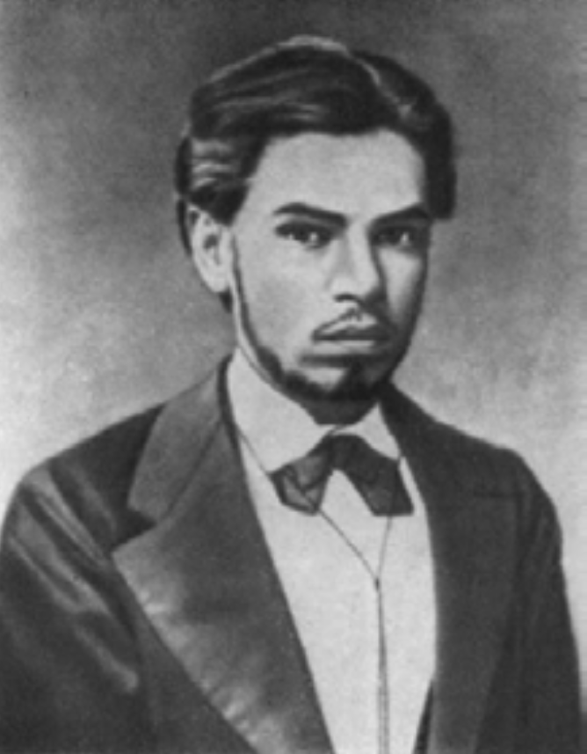
Aleksandr Lyapunov (1857 – 1918)
Russian mathematician, regarded as Father of modern theory of stability.
Student of Chebyshev and he also collaborated with Markov.
  Bifurcation problem : Is it true that the ellipsoid is transformed at a critical velocity into new equilibrium forms?
The period marked turmoil in Russia but he only talked Math and science to everyone
Extremely reserved and hard working (gave many lectures without sleeping).
He was too fond of his wife; shot himself when his wife died of tuberculosis.

Slide 3
Outline of the lecture
System designing

Slide 4
Different approaches
Graphical method
Step-by-step method
Guess method
Polynomial approach

Slide 5
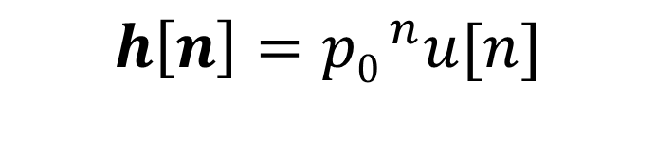
Basic DT system
$$h\left[n\right]={p0 }^{n}u[n]$$
p_{o}
Delay

Slide 6
Representing in elementary form
+
Delay
1.2
Delay
-0.32

Slide 7


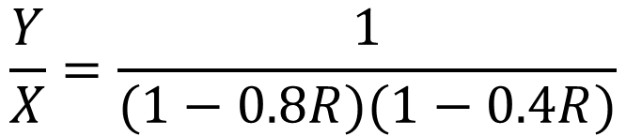
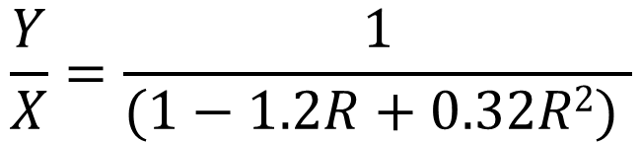
Representing in elementary form
$$Y=X+1.2RY−0.32R2Y$$
$$Y(1−1.2R+0.32R2)=X$$
$$\frac{Y}{X}=\frac{1}{(1−1.2R+0.32R2) }$$
$$\frac{Y}{X}=\frac{1}{(1−0.8R)(1−0.4R)}$$

Slide 8
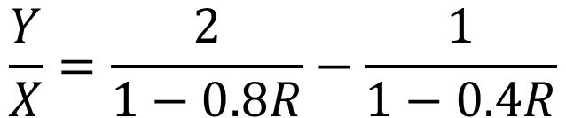
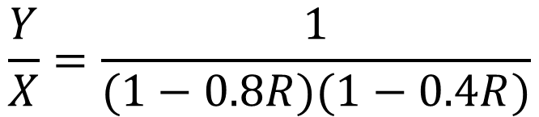
Representing in elementary form
$$\frac{Y}{X}=\frac{1}{(1−0.8R)(1−0.4R)}$$
$$\frac{Y}{X}=\frac{2}{1−0.8R}−\frac{1}{1−0.4R}$$

Slide 9
Representing in elementary form
+
+
2
Delay
Delay
0.8
+
1.2
+
-1
Delay
Delay
-0.32
0.4

Slide 10
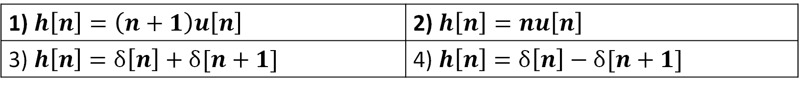
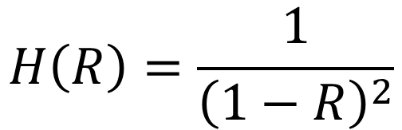
Find the impulse response of the system:
$$H\left(R\right)=\frac{1}{{\left(1−R\right)}^{2}}$$
1) $h\left[n\right]=\left(n+1\right)u\left[n\right]$ | 2) $h\left[n\right]=nu\left[n\right]$
3) $h\left[n\right]=δ\left[n\right]+δ[n+1]$ | 4) $h\left[n\right]=δ\left[n\right]−δ[n+1]$

Slide 11
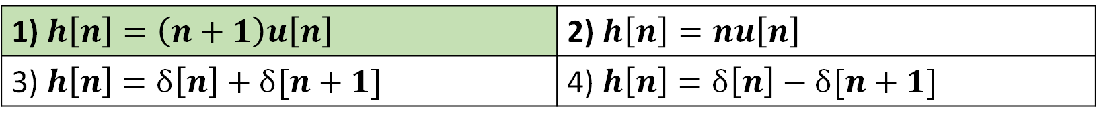
Find the impulse response of the system:
$$H\left(R\right)=\frac{1}{{\left(1−R\right)}^{2}}$$
1) $h\left[n\right]=\left(n+1\right)u\left[n\right]$ | 2) $h\left[n\right]=nu\left[n\right]$
3) $h\left[n\right]=δ\left[n\right]+δ[n+1]$ | 4) $h\left[n\right]=δ\left[n\right]−δ[n+1]$

Slide 12
CT system (Graphical)
Basic CT system
A
p

Slide 13
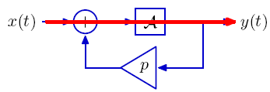
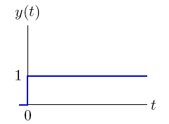
CT system (Graphical)
Basic CT system
A
h(t)=1
p

Slide 14
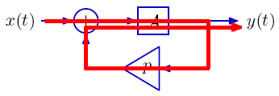
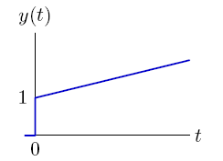
CT system (Graphical)
Basic CT system
A
h(t)=1+pt
p

Slide 15
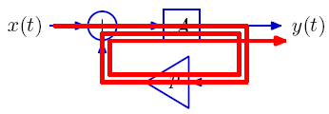
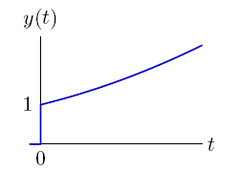
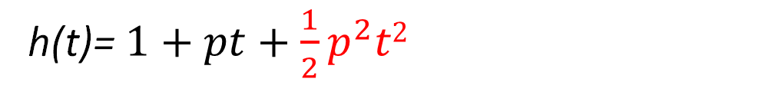
CT system (Graphical)
Basic CT system
A
h(t)= $1+pt+\frac{1}{2}p^{2}t2$
p

Slide 16
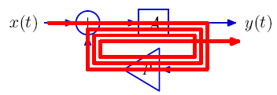
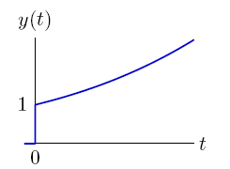
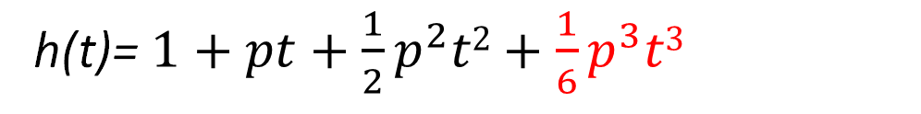
CT system (Graphical)
Basic CT system
A
h(t)= $1+pt+\frac{1}{2}p^{2}t2+\frac{1}{6}p^{3}t3$
p

Slide 17
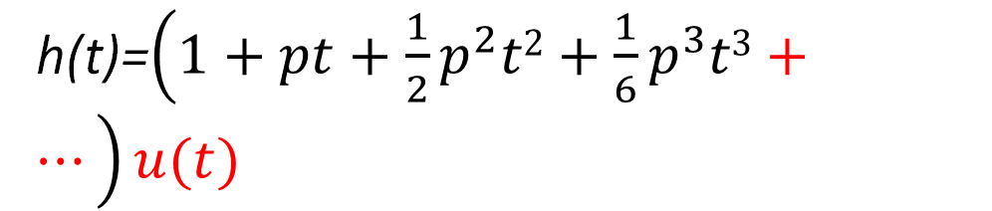
CT system (Graphical)
Basic CT system
A
h(t)=$\left(1+pt+\frac{1}{2}p^{2}t2+\frac{1}{6}p^{3}t3+…\right)u(t)$
p

Slide 18
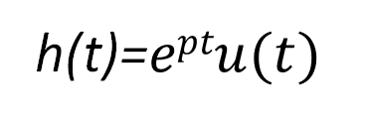
CT system (Graphical)
Basic CT system
A
h(t)=$eptu(t)$
p

Slide 19
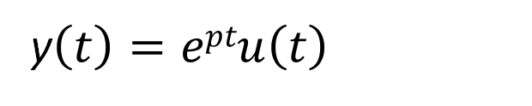
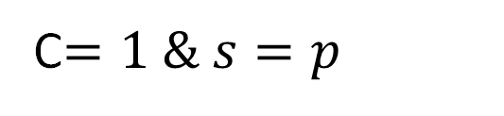
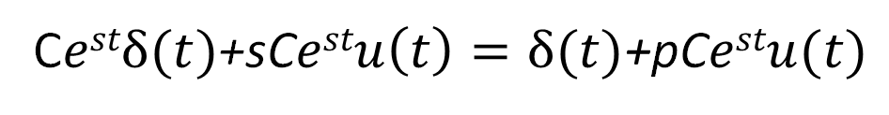
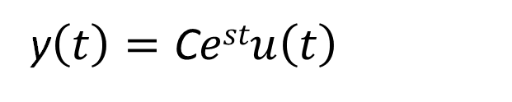

CT system (Guess) not understood
$$\dot{y\left(t\right)}=x\left(t\right)+py(t)$$
By Guess
Basic CT system
y$\left(t\right)=\text{C}estu\left(t\right)$
Substituting
A
C$estδ(t)$+sC$estu\left(t\right)=δ(t)\text{+}$pC$estu(t)$
p
Comparing
C$=1 \& s=p$
y$\left(t\right)=eptu\left(t\right)$

Slide 20
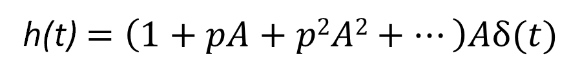
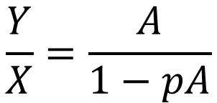
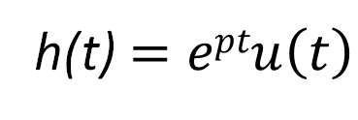

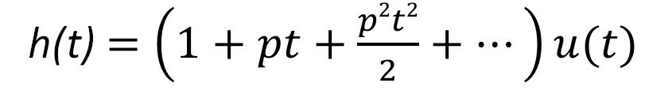
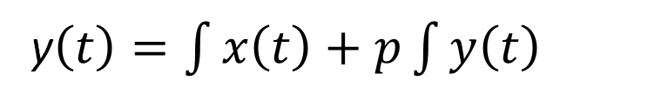

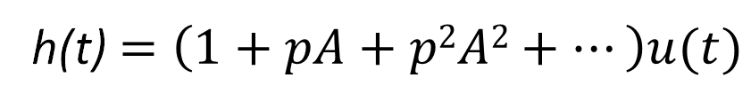
CT system (Polynomial)
$$\dot{y\left(t\right)}=x\left(t\right)+py(t)$$
y$\left(t\right)=\int{x\left(t\right)+p}\int{y\left(t\right)}$
Basic CT system
Operator
$$Y=AX+pAY$$
$$\frac{Y}{X}=\frac{A}{1−pA}$$
A
h(t)$=\left(1+pA+p2A2+…\right)Aδ(t)$
p
h(t)$=\left(1+pA+p2A2+…\right)u(t)$
h(t)$=\left(1+pt+\frac{p2t2}{2}+…\right)u(t)$
h(t)$=eptu\left(t\right)$

Slide 21
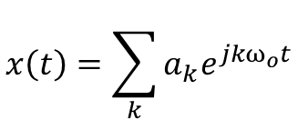
Why does polynomials work even for CT system?
Fourier series/Fourier Transforms
$$x\left(t\right)=\sum_{k}{a_{k}e^{jkω_{o}t}}$$
$$x\left(t\right)=a_{0}+a_{1}t+a_{2}t^{2}+a_{3}t^{3}+…$$
$$x\left(t\right)=b_{0}+b_{1}A+b_{2}A^{2}+b_{3}A^{3}+…$$

Slide 22
CT and DT system
Basic CT system
Basic DT system
A
p
p_{o}
D

Slide 23
Impulse-invariance
Basic CT system
Basic DT system
A
p
e^{p}
D

Slide 24

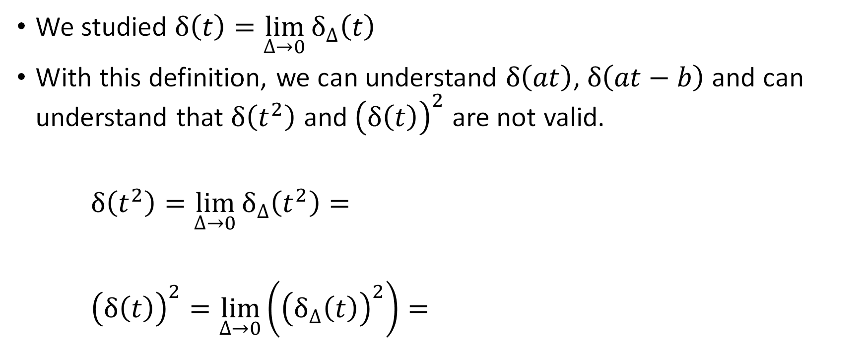






Generalized functions
We studied $δ\left(t\right)=\lim_{∆→0}{δ_{∆}\left(t\right)}$
With this definition, we can understand $δ\left(at\right)$, $δ\left(at−b\right)$ and can understand that $δ\left(t^{2}\right)$ and ${\left(δ\left(t\right)\right)}^{2}$ are not valid.
$δ\left(t^{2}\right)=\lim_{∆→0}{δ_{∆}\left(t^{2}\right)=}$
${\left(δ\left(t\right)\right)}^{2}=\lim_{∆→0}\left({\left(δ_{∆}\left(t\right)\right)}^{2}\right)=$
$$\frac{1}{∆}$$
$$≈$$
∞
$$\sqrt{∆}$$
$$0$$
$$\frac{1}{∆^{2}}$$
$$≈$$
∞
∆
$$0$$

Slide 25
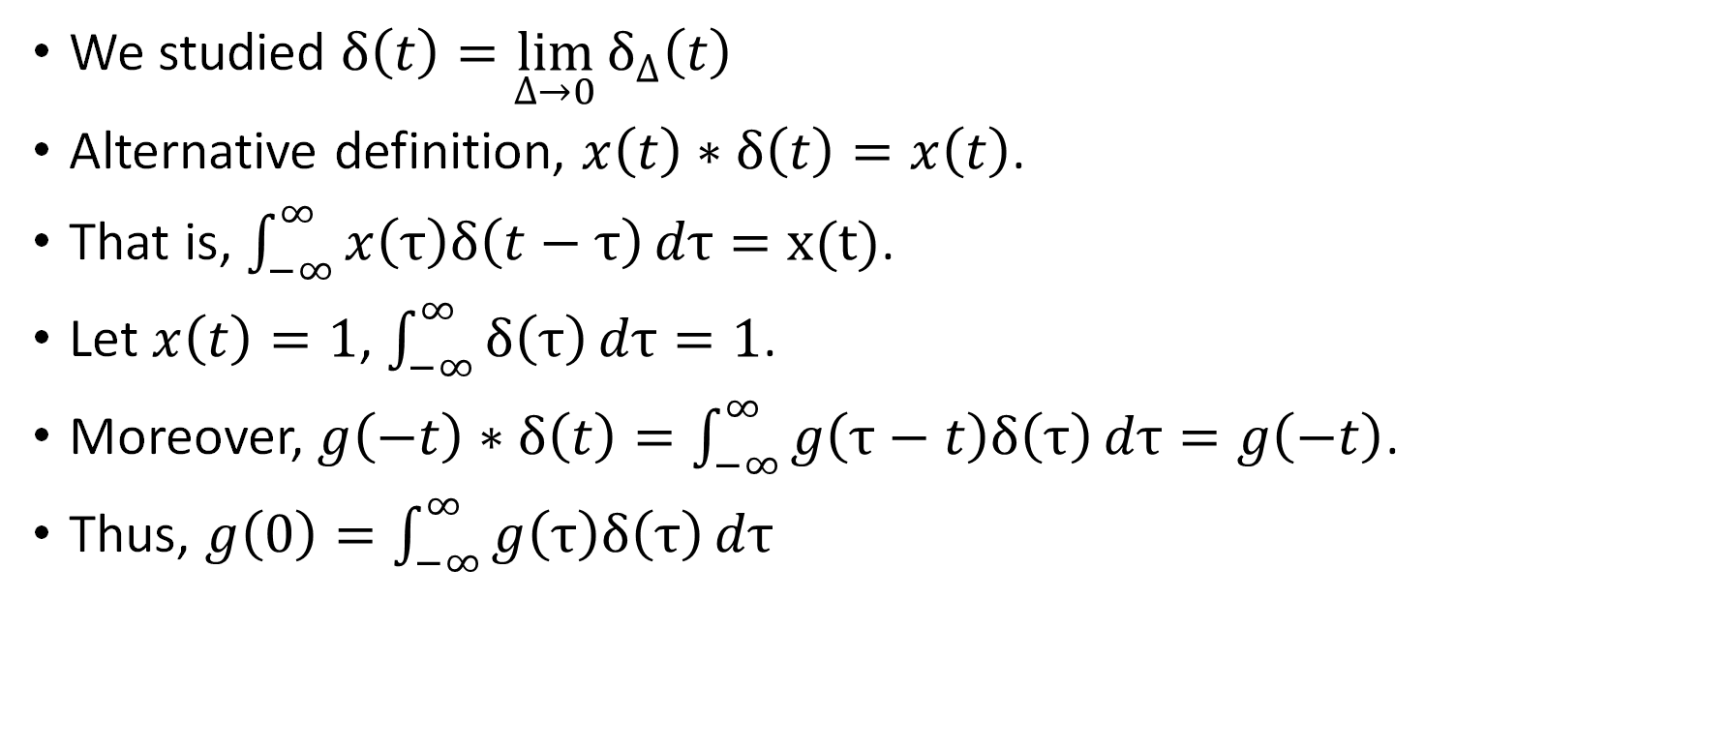
Generalized functions
We studied $δ\left(t\right)=\lim_{∆→0}{δ_{∆}\left(t\right)}$
Alternative definition, $x\left(t\right)∗δ\left(t\right)=x\left(t\right)$.
That is, $\int_{−∞}^{∞}{x\left(τ\right)δ\left(t−τ\right)}dτ=x(t)$.
Let $x\left(t\right)=1$, $\int_{−∞}^{∞}{δ\left(τ\right)}dτ=1$.
Moreover, $g\left(−t\right)∗δ\left(t\right)=\int_{−∞}^{∞}{g\left(τ−t\right)δ\left(τ\right)}dτ=g\left(−t\right)$.
Thus, $g\left(0\right)=\int_{−∞}^{∞}{g\left(τ\right)δ\left(τ\right)}dτ$

Slide 26
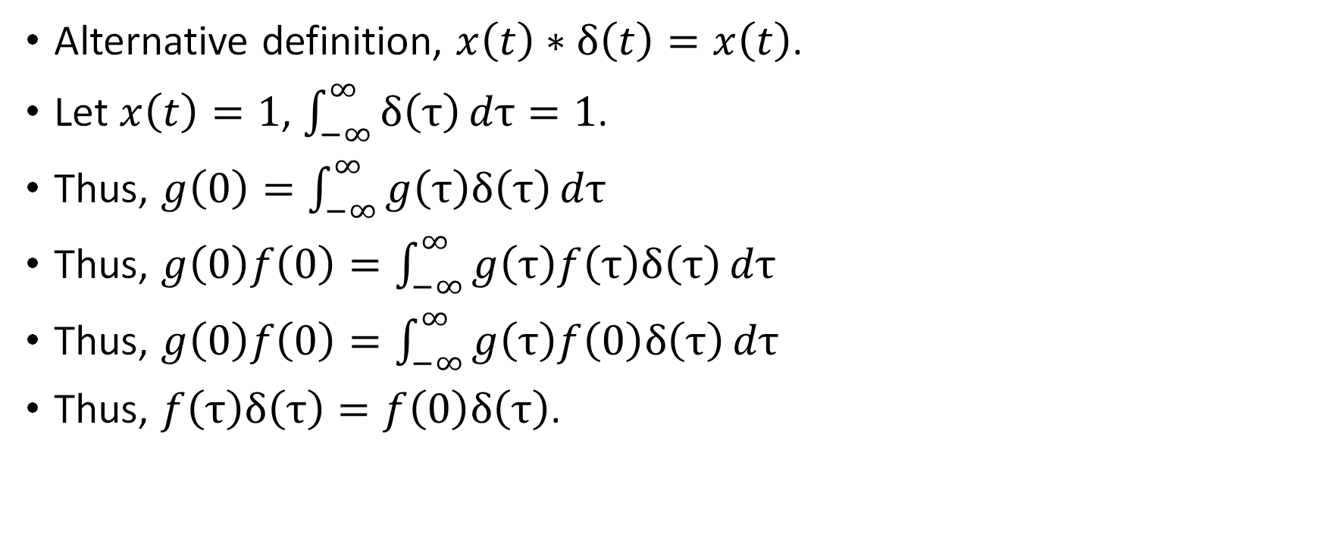
Generalized functions
Alternative definition, $x\left(t\right)∗δ\left(t\right)=x\left(t\right)$.
Let $x\left(t\right)=1$, $\int_{−∞}^{∞}{δ\left(τ\right)}dτ=1$.
Thus, $g\left(0\right)=\int_{−∞}^{∞}{g\left(τ\right)δ\left(τ\right)}dτ$
Thus, $g\left(0\right)f\left(0\right)=\int_{−∞}^{∞}{g\left(τ\right)f\left(τ\right)δ\left(τ\right)}dτ$
Thus, $g\left(0\right)f\left(0\right)=\int_{−∞}^{∞}{g\left(τ\right)f\left(0\right)δ\left(τ\right)}dτ$
Thus, $f\left(τ\right)δ\left(τ\right)=f\left(0\right)δ\left(τ\right)$.

Slide 27
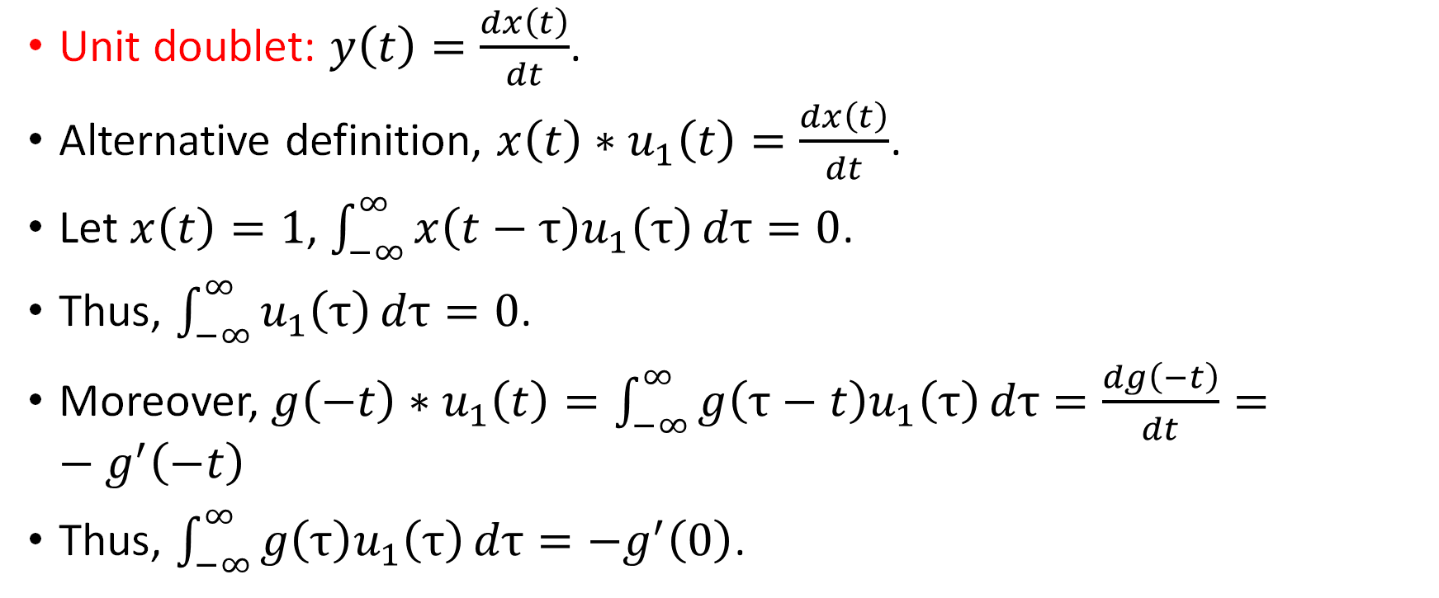
Generalized functions
Unit doublet: $y\left(t\right)=\frac{dx\left(t\right)}{dt}$.
Alternative definition, $x\left(t\right)∗u_{1}\left(t\right)=\frac{dx\left(t\right)}{dt}$.
Let $x\left(t\right)=1$, $\int_{−∞}^{∞}{x\left(t−τ\right)u_{1}\left(τ\right)}dτ=0$.
Thus, $\int_{−∞}^{∞}{u_{1}\left(τ\right)}dτ=0$.
Moreover, $g\left(−t\right)∗u_{1}\left(t\right)=\int_{−∞}^{∞}{g\left(τ−t\right)u_{1}\left(τ\right)}dτ=\frac{dg\left(−t\right)}{dt}=−g^{′}\left(−t\right)$
Thus, $\int_{−∞}^{∞}{g\left(τ\right)u_{1}\left(τ\right)}dτ=−g^{′}\left(0\right)$.

